Slide 1

Custom Web UI Using Torizon
(or how to build a custom web page for your IoT device)

Slide 2

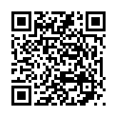

https://www.linkedin.com/in/daniel-stefan-267793300/

Slide 3



Index
Setup
How to access your device via Torizon API
Code
Design / implement your web page
Publish
Launch your web page and make it accessible

Slide 4
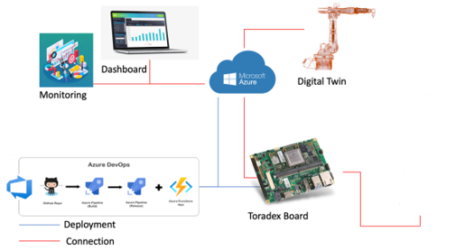
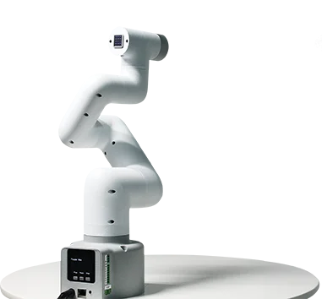
Original Idea
Custom Web UI for any IoT device using Toradex (Erni IoT Showcase)
Carrier Board: Yavia | Família Verdin SoM: NXP i.MX 8M Plus
Torizon OS
Toradex Torizon Platform used for Fleet management and OTA
Controlling 6-axis Robotic Arm myCobot280 from elephantrobotics
Microsoft Azure used for - DevOps - Mqtt Broker - Web Interface - Monitoring

Slide 5
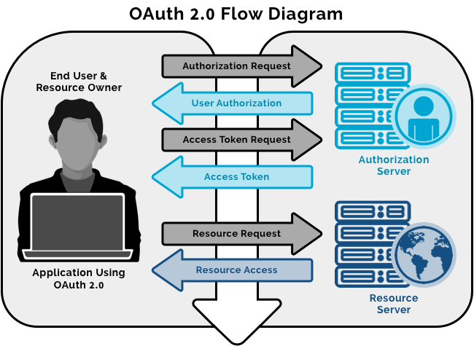
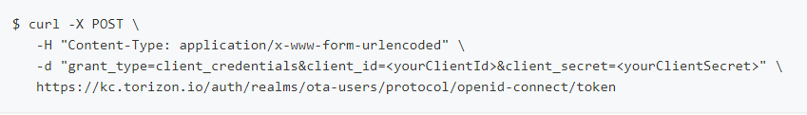
Setup
How to access your device via Torizon API
How-To provision a device (Via Torizon Cloud UI -> https://app.torizon.io/#/)
How-To create an API client (Via Torizon Cloud UI -> https://app.torizon.io/#/account -> API Client Manager) (Info: Set the token lifetime here!) (Note that you won't be able to see the secret after closing the form)
How-To get an API token (Request an API token with your ClientId & Client secret)
Check your API accesss
OpenAPI Specification

Slide 6
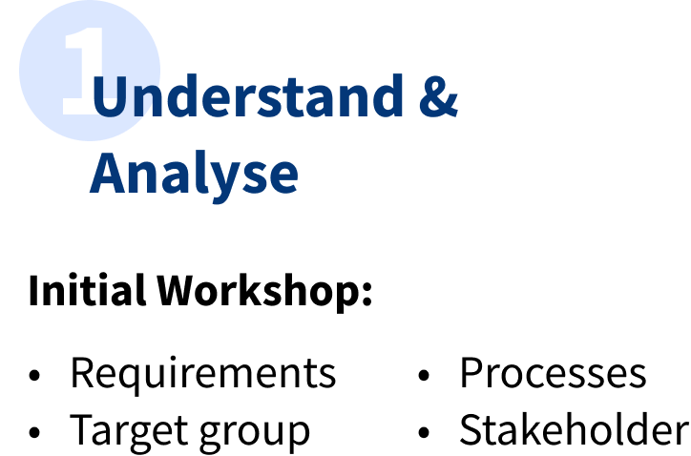
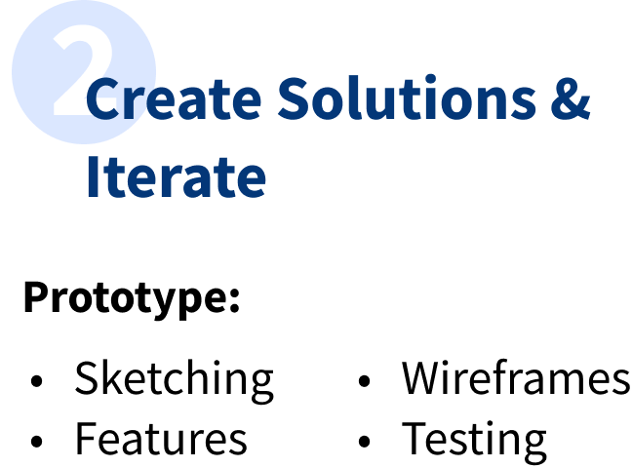

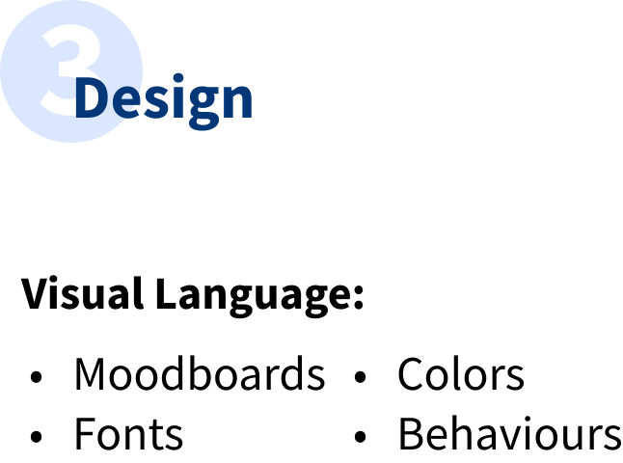



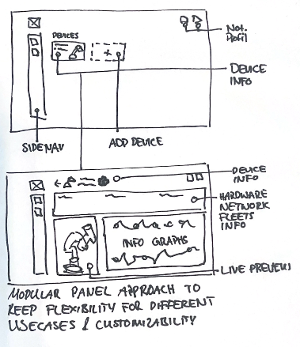
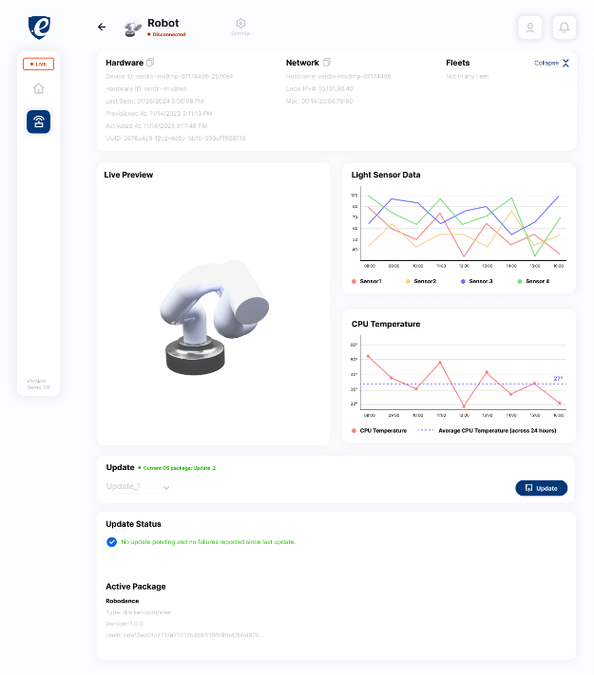
Design
Design your page
Notes:
Design is about good expirience, and building a good foundation for a product

Slide 7
Code
Implementation - Setup
Our setup - vscode - nodejs (why -> open-source, cross plattform, C++/javascript, + easy)
Lets code, https://github.com/erni-dan/custom-torizon-ui (torizon custom example) follow https://github.com/erni-dan/custom-torizon-ui-talk (live coding) $ npx express-generator –view=ejs $ npm install axios –save //HTTP Client $ npm install & npm update $ npm start
Check http://localhost:3000/
Notes:
Python + c#

Slide 8
Code - Recap
Implementation – Access Torizon API via axios HTTP client
Copied https://github.com/erni-dan/custom-torizon-ui/blob/master/torizon_api.js into project and API bearer token into the variable api_bearer_token
Added HTML dependencies to your page https://getbootstrap.com/docs/4.0/getting-started/download/
Got familiar with ejs template engine https://www.digitalocean.com/community/tutorials/how-to-use-ejs-to-template-your-node-application

Slide 9
Github Repository
custom-torizon-ui
https://github.com/erni-dan/custom-torizon-ui
Browse Web Page -> https://iot-showcase-ui-embedded-world.azurewebsites.net/
https://github.com/erni-dan/custom-torizon-ui-talk (Presentation + Live Code)

Slide 10
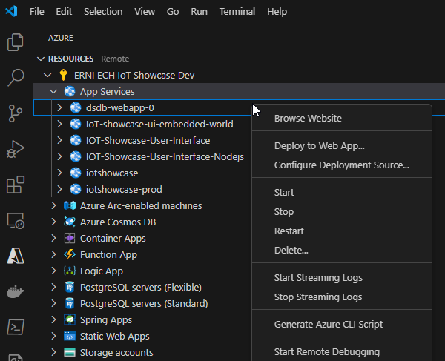
Publish
Launch your web page
Our setup - vscode - Azure Tools extension
Remark: Use extension for deployment only for tests. In Productive environment use your CI/CD pipeline to deploy

Slide 11
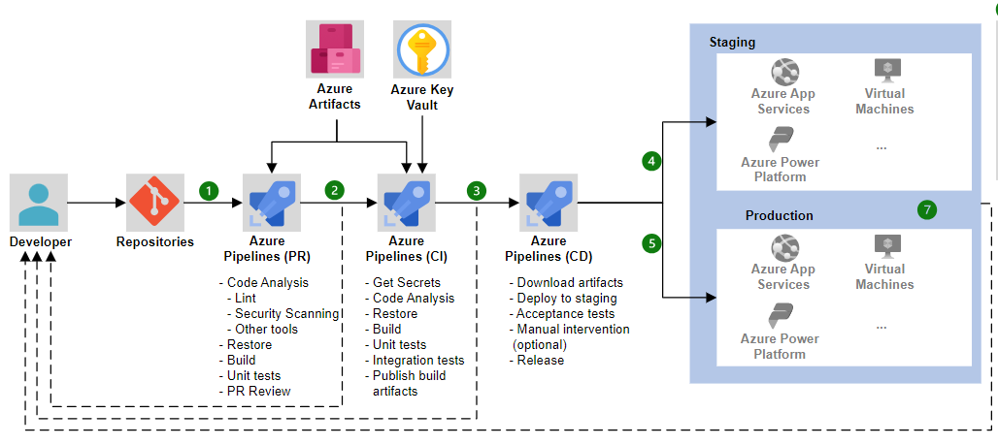
Publish
Launch your web page
Remark: Use extension for deployment only for tests. In Productive environment use your CI/CD pipeline to deploy

Slide 12
https://www.linkedin.com/in/daniel-stefan-267793300/

